Slide 1

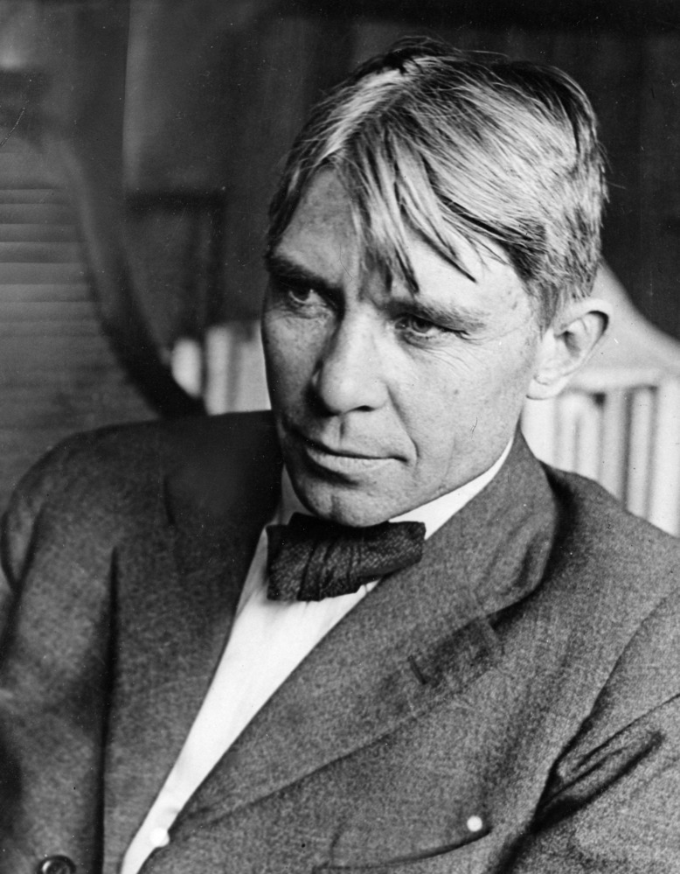
"Poet of the People“
Carl Sandburg provided a popular voice for the American people of the twentieth century and still speaks to us through his words, activism, music and the beauty and serenity of Carl Sandburg Home National Historic Site.
www.nps.gov/carl

Slide 2
“Fog” by Carl Sandburg
Grades 3rd - 5th
Carl Sandburg was known as the Poet of the People. He loved writing so much that he wrote poetry, children's stories, news articles, and a biography about Abraham Lincoln, as well as an autobiography about himself.
Tasks:
Listen to Carl Sandburg read his poem “Fog”
Answer questions about his poem on the next slide.
3) Compare snow to a snowy owl.
4) Write your own figurative language poem.

Slide 3
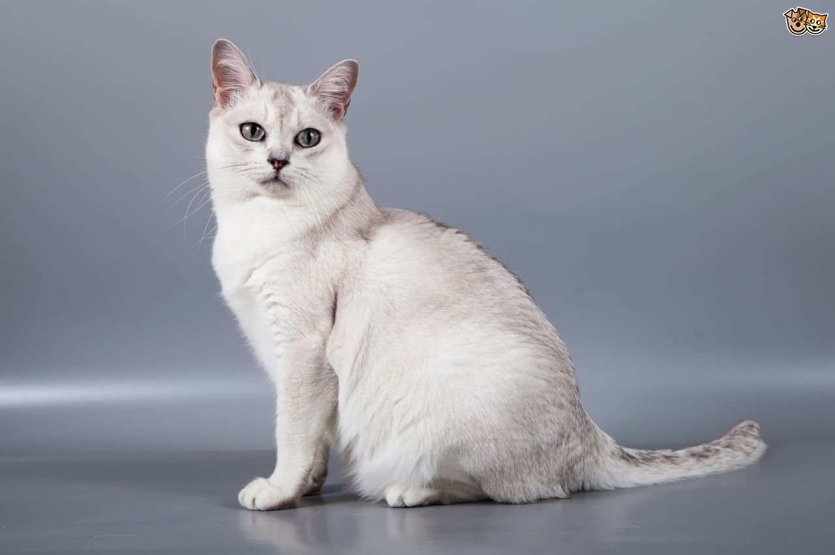
Click here https://www.youtube.com/watch?v=vMgJzVCRCNk to listen to Carl Sandburg read his poem “Fog”.
Fog
by Carl Sandburg
The fog comes
on little cat feet.
It sits looking
over city and harbor
on silent haunches
and then moves on.
Haunches buttock and thigh considered together, in a human or animal

Slide 4

After reading the poem, answer the questions below using supporting details from the poem. Remember to write using complete sentences!
Carl Sandburg used figurative language (metaphor) to compare the fog to a cat.
Why do you think he chose to do that?
What are the similarities between fog and a cat?
Write your response here…
Click here https://www.youtube.com/watch?v=0_f8LPVqn0o to watch a video of fog if you aren’t sure what it looks like.

Slide 5

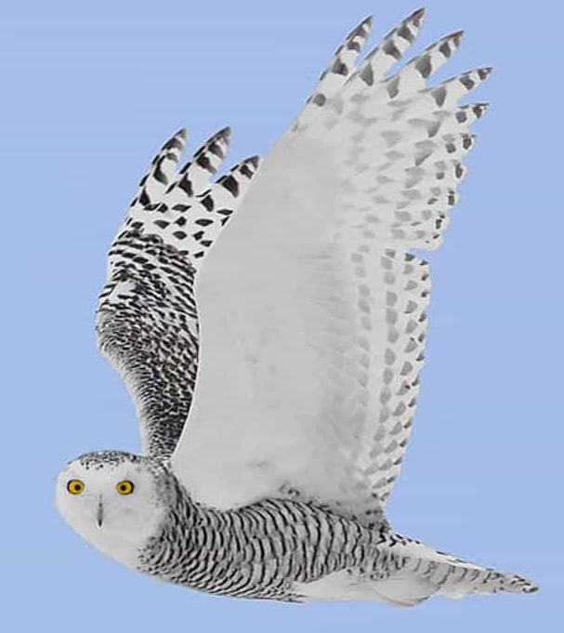
Now think about snow and a snowy owl.
How do they both move?
What do they both look like? What do they both feel like?
How is snow similar to a snowy owl?
Write your response here…

Slide 6
Now write your own poem using figurative language to compare snow to a snowy owl. Look back at Carl Sandburg’s poem to get ideas on how to format your own. Insert a picture to illustrate your poem.
Write your poem here…
Insert your picture here…

